Slide 1
Updates on CDN Environment Automation Managing a CDN Operating System at Scale
Sept, 22nd, 2021

Slide 2
BIO
Jonathan Gray
Comcast Content Delivery Network Team
Site Reliability Engineer 4
Twitter : @jhg03a
GitHub : @jhg03a
asf.slack.com : @jhg03a
jhg03a@apache.org
https://about.twitter.com/en_us/company/brand-resources.html
https://github.com/logos
https://slack.com/media-kit https://commons.wikimedia.org/wiki/File:Antu_mail-folder-sent.svg

Slide 3
What’s new

Slide 4
Committers This year – Ansible
Ashish P
Eric Friedrich
Evan Zelkowitz
Jeremy Mitchell
Jonathan G
Rawlin Peters
Robert O Butts
Srijeet Chatterjee
Steve Hamrick
Zach Hoffman
jhowar201
git shortlog --no-merges -n -s --since "29 Sept 2020" -- infrastructure/ansible/ | tr -s ' ' ' ' | tr -s '\t' ' ' | cut -d' ' -f3- | sort
Notes:
11

Slide 5
Significant Changes merged This year – Ansible
Feature
Add support for leveraging Postgresql versions >9.6
Major performance improvement to the dataset loader role
Add/Switch default support from Riak-based Traffic Vault to be Postgresql-based
Add federations to initial cdn dataset
Maintenance
Add support for TO Golang plugin configuration
Add/Switch default support from ORT to t3c
Separate out static file hosting from Traffic Ops
Performance and versioning updates to configuration defaults
Upgrade from Traffic Ops API 1.3 usage to 2.0
General bugfixes and Cleanup
git shortlog --no-merges -n --since "29 Sept 2020" -- infrastructure/ansible/

Slide 6
1. Continued unstable work – Ansible
https://github.com/jhg03a/trafficcontrol/tree/ansible.refactor/infrastructure/ansible/
ATS
Add support to erase ATS cache data prior to reinstall
New ATS Profile/Parameter maintenance tooling
ATS8 support including a major overhaul/cleanup for parameters
Support for automatically building ATS Profiles by hardware variance
git shortlog --no-merges -n --since "29 Sept 2020" -- infrastructure/ansible/

Slide 7
2. Continued unstable work – Ansible
https://github.com/jhg03a/trafficcontrol/tree/ansible.refactor/infrastructure/ansible/
Dataset Loader
Add per component TO server defaults
General refactor and cleanup of the dataset loader role
git shortlog --no-merges -n --since "29 Sept 2020" -- infrastructure/ansible/

Slide 8
3. Continued unstable work – Ansible
https://github.com/jhg03a/trafficcontrol/tree/ansible.refactor/infrastructure/ansible/
TODB
TODB IPv6 support
TODB Waterfall replication
git shortlog --no-merges -n --since "29 Sept 2020" -- infrastructure/ansible/

Slide 9
4. Continued unstable work – Ansible
https://github.com/jhg03a/trafficcontrol/tree/ansible.refactor/infrastructure/ansible/
MISC
TO Let’s Encrypt configuration support
TP UI Default value improvements
General performance improvements and bugfixes
Testing!
git shortlog --no-merges -n --since "29 Sept 2020" -- infrastructure/ansible/

Slide 10
CI Testing
Infra automation and testing hooks
Pluggable provisioning backend
Docker by default, but others exist
Driven by Ansible
Includes hooks for linters
Yamllint
Ansible lint
Supports Ansible-based testing assertions
Testing for Idempotency
https://github.com/ansible-community/molecule/blob/main/docs/_static/images/logo_big.png

Slide 11
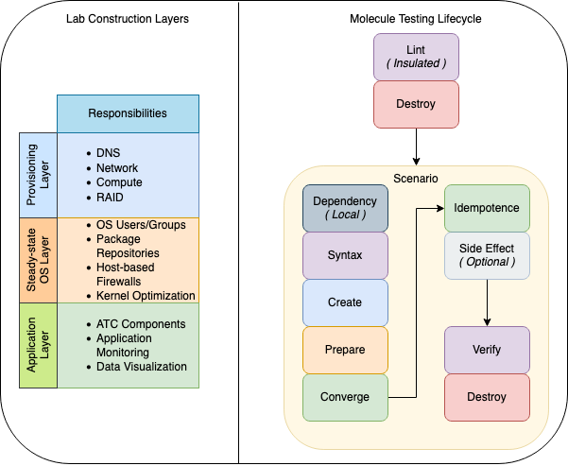
Molecule Overview
Per Role ( ATC Component)
Per Environment

Slide 12
Plumbing in place
Lint
Common yamllint and ansible lint config files
Dependency
Build RPMs if necessary
Create a persistent SSL Root CA and Intermediate CA
Fabricate persistent random secrets
Prepare
Generate host SSL certs and add CA
Convert RPM cache into an auto-updating YUM repo already available
Github Actions
Execute on updates to Fake Origin or TODB
Execute multiple scenarios for different topologies and CentOS versions
Photo by Samuel Sianipar on Unsplash

Slide 13
Managing A CDN Operating system at scale

Slide 14
Why Ansible
An option, not the only option
Could coexist with other existing solutions such as ORT and puppet
Mature
Had more scalable backend requirements with more well understood operability and observability
Had a much simpler learning curve
Worked on everything with batteries included
Adoption could be as small or large as desired
We had the skillsets already developed or could cheaply obtain them
It’s the current RedHat recommendation
Can operate as both centralized or decentralized
Other well-established options
Puppet
Chef
Salt
Custom scripting
Immutable Infrastructure
Containers
Vagrant Images

Slide 15
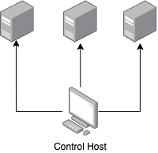
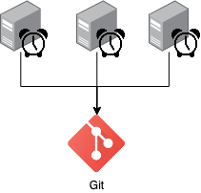
Ansible workflows
Ansible (Push)
Ansible-pull
“Do this”
“Do what applies”

Slide 16
Basic Repository
https://github.com/jktr/ansible-pull-example
Photo by Branden Tate on Unsplash

Slide 17
Basic Example Enhancements - Inventory
Possible functional expansions around managing The Ansible-pull Inventory
Executable files adhering to calling conventions and output format rules
Existing Dynamic Inventory Script - https://github.com/apache/trafficcontrol/tree/master/infrastructure/ansible/dynamic.inventory
Static inventory files
JSON
YAML
INI

Slide 18
Basic Example Enhancements - Wrapper
Possible functional expansions around managing Ansible-pull
Finer controls around execution conditions
Separating run scopes for time constraints via tags or separate playbook
Triggering conditions:
Fast scheduled enforcement on reduced scope
Slow scheduled enforcement on full scope
Full scope enforcement on reboot
Full scope enforcement on failed execution
Full scope enforcement on repository change
Failsafe enforcement in the event of connectivity losses
Consistent Dispersion
Maintenance mode
Finer controls around external code dependency management
Multi-branch support

Slide 19
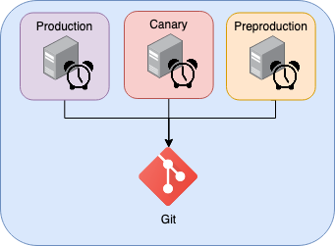
Basic Example Enhancements – Git Workflows
Gitops
Strategy
PR

Slide 20
Security

Slide 21
Security to the Repository
Securing Ansible-pull itself
All existing security features of Git
http/https/ssh Transport
Includes any required ssh/sftp/scp command options
Commiter/Authorship requirements
Testing/Merge requirements
Requiring Signed Commits
Force checkouts to prevent local edit merge conflicts
Git branch assignment change management
Photo by Michael Dziedzic on Unsplash

Slide 22
Security Inside the Repository
Securing Ansible-pull Contents
Ansible-Vault
Removing secrets via Lookup Plugins
AWS Secrets Manager
Etcd
CyberArk
Keyring
Lastpass
OnePassword
HashiCorp Vault
Redis
Thycotic Secret Server
"Ancient Egyptian Stone Tablet" by Gary Lee Todd, Ph.D. is marked with CC0 1.0

Slide 23
Logging

Slide 24
Knowing what’s going on
Default stdout feeding journald
Augmenting or replacing via Callback Plugins
JUnit xml files
JSON formatted stdout
Syslog as JSON
Azure Log Analytics
LogDNA
Foreman
Logstash
Nagios
Slack
Splunk
SumoLogic
"Inside the IBM 1403 line printer." by phrenologist is licensed under CC BY-NC 2.0

Slide 25
Takeaways
The ansible aspects of ATC are continuing forward by multiple contributors and quality
Ansible-pull can be leveraged as a framework for maintaining stateful Operating Systems at scale
Jonathan Gray
Twitter : @jhg03a
GitHub : @jhg03a
asf.slack.com : @jhg03a
jhg03a@apache.org
https://unsplash.com/photos/R4WCbazrD1g
https://about.twitter.com/en_us/company/brand-resources.html
https://github.com/logos
https://slack.com/media-kit https://commons.wikimedia.org/wiki/File:Antu_mail-folder-sent.svg

