Slide 1

2018 Traffic Control Spring Summit
Dave Neuman neuman@apache.org
April 24 – 25, 2018
Boxborough, MA

Slide 2

Welcome!
Almost 30 attendees from 7 different companies
Full scheduled of talks
GPG Key signing party, Documentation scrub, Etc
Schedule can be found on the wiki: https://cwiki.apache.org/confluence/display/TC/Events
http://trafficcontrol.apache.org/events/current-event/
Notes:
Name Tags
Show of hands for first timers
Welcome!

Slide 3
Housekeeping
Location related items (Bathrooms, Cafeterias, Etc.)
Breaks
Breakfast and Lunch provided both days!
Dinner – 5:30 at Tavern in the Square
Thanks Eric for all the hard work getting this setup!

Slide 4
Since our last summit (October 2017)
Released Traffic Control 2.1
457 Pull Requests submitted
411 Pull Requests merged
1046 commits to Master
45 unique contributors
267 Issues opened
192 Issues Closed/Resolved
579 emails on dev list by 52 people divided into 92 topics
53 emails on users list by 18 people divided into 15 topics
Notes:
372 currently open!
We should go through them!

Slide 5
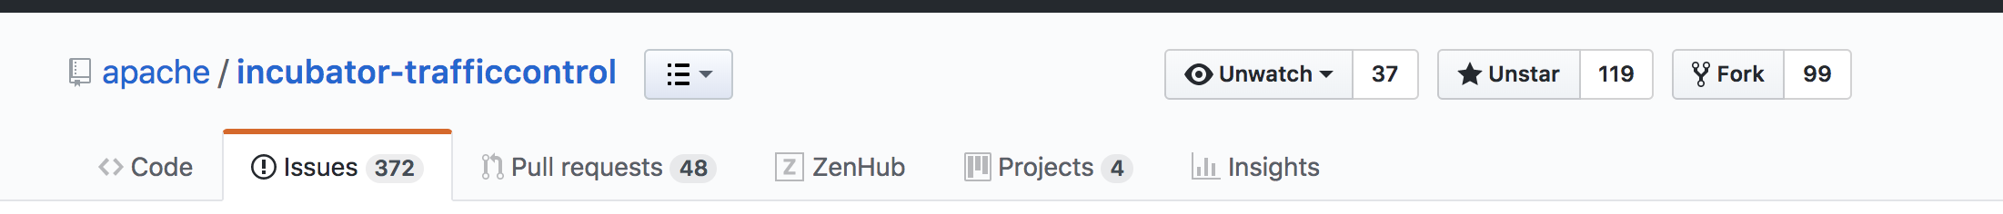
More fun stats
119 stars on GitHub
99 forks on GitHub
37 watchers on GitHub
~270 slack users
Approximately 1,000,000 questions answered on Slack ☺

Slide 6
Traffic Control 2.2
Last release in the incubator
Go vote on RC5!

Slide 7
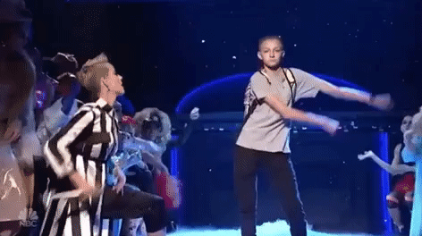
Graduation!!!
IPMC VOTE closed today, we passed!
Next step is to submit resolution to the board - aiming for acceptance at May 16th board meeting
Need to setup a new GitHub and move code/issues
No longer need IPMC for releases
Easier to nominate committers

Slide 8
Open questions
Release cadence?
LTS?
Next Release?
Website update?
Follow up on-list

Slide 9

September 24 – 27 in Montreal, Quebec
At least 2 Traffic Control talks have been accepted
Plan on Traffic Control summit either before or during ApacheCon
Planning a Traffic Control graduation party
http://apachecon.com/acna18/?ref=apachecon.com

