Slide 1
CDN Locks: A way to ensure data integrity in the CDN
Srijeet Chatterjee
Senior Software Engineer / Comcast

Slide 2
A Little bit about me
Originally from India
Moved to the US (Colorado) in 2011
Been with Comcast for 5 years
Been with the CDN team for 1.5 years
Likes:
Coding, playing outdoor sports, hiking, beer (yay, Denver)
Dislikes:
Snow and cold weather (boo, Denver)

Slide 3
CDN Locks: Why, What, How
Image courtesy: "Security" by CarbonNYC [in SF!] is licensed with CC BY 2.0. To view a copy of this license, visit https://creativecommons.org/licenses/by/2.0/

Slide 4
The Why…
To mitigate the risks associated with multi user access to traffic ops (snapshots and queues)
To guarantee data parity and integrity while snapping or queueing
To eliminate (or reduce, at least) the human errors associated with these operations. Currently, the CDN team at Comcast depends on slack messages to communicate this.
To make sure a user has “full control” over their actions (nobody else can snap/ queue before I’m done)

Slide 5
The What…
A simple database object, specifying the user name, cdn name, message (optional) and type (to be explained later)
API accessible
One CDN => One lock at a time
Optional: Users may/ may not use this feature
Introduced in ATC 6.0 (API 4.0)

Slide 6
The How…
User “A” creates a lock for a CDN “foo”
If the above operation succeeds, no other user can “dirty” this CDN (depending on the type of the lock)
When ”A” is done modifying/ snapping/ queueing the CDN, they release the lock, or unlock the CDN “foo”
Now the CDN “foo” is open to anyone and everyone else (with the right permissions) to modify

Slide 7
The CDN_Lock object
Field | Type | Optionality | Description
userName | string | required | the user name of the user that wants to acquire a lock on the CDN
cdn | string | required | the name of the CDN on which the lcok needs to be acquired
message | string | optional | the message stating a reason behind locking the CDN
soft | boolean | required | whether or not this is a shared lock, i.e., if a user has the lock, whether or not other users can make changes to the CDN
lastUpdated | time | required | the last time this lock was updated

Slide 8
Soft (shared) vs Hard (exclusive) locks
Soft locks: Anybody can make changes but only you can snap/ queue your CDN.
By default, if nothing is specified while creating a lock, the system assumes it to be a “soft” lock.
This is a multi user lock, useful in times when a bunch of users is working on a Project, for example, DS updates or cert updates.
Hard locks: Only you can make changes and snap/ queue your CDN.
This is for the times when you want exclusivity on the CDN, and do not allow others to make any change whatsoever.

Slide 9
GET /api/4.0/cdn_locks
{ "response": [
{
"userName": "admin",
"cdn": "over-the-top",
"message": "snapping cdn",
"soft": true,
"lastUpdated": "2021-09-09T13:51:19.103836-06:00"
}
]}

Slide 10
POST /api/4.0/cdn_locks
Response structure:
{ "alerts": [
{
"text": "hard CDN lock acquired!",
"level": "success"
} ],
"response": {
"userName": "foo",
"cdn": "bar",
"message": "snapping cdn",
"soft": false,
"lastUpdated": "2021-05-10T17:05:30-06:00" } }
Request structure:
{ “cdn": "bar",
"message": "snapping cdn",
"soft": false
}

Slide 11
DELETE /api/4.0/cdn_locks?cdn=bar
{ "alerts": [
{
"text": ”CDN lock deleted",
"level": "success"
} ],
"response": {
"userName": "foo",
"cdn": "bar",
"message": "snapping cdn",
"soft": false,
"lastUpdated": "2021-05-10T17:05:30-06:00" }
}

Slide 12
A note on deleting CDN locks
A user can delete their own locks on CDNs.
A user with admin role can delete any other user’s locks if need be.

Slide 13
Locks validation
A user can have 0 or more locks.
A user can have a maximum of 1 lock (soft/ hard) per CDN.
A CDN can have a maximum of 1 lock (soft/ hard).
If a CDN is deleted, the lock associated with it is also deleted.

Slide 14
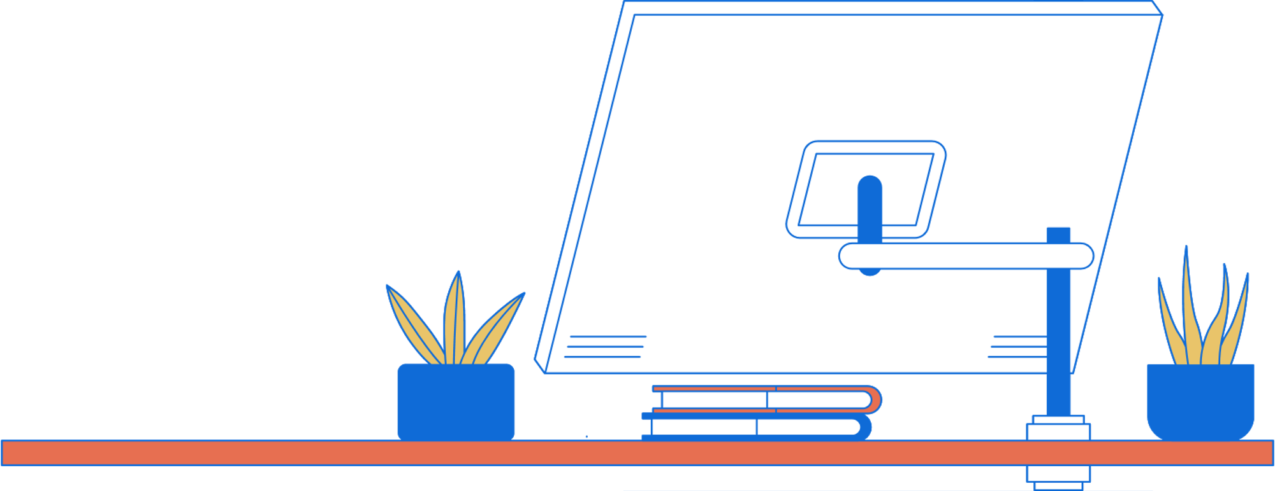
DEMO
Image courtesy: https://www.pexels.com/photo/matrix-background-1089438/

Slide 15
Future work
Allow for a “ttl” field in cdn_locks to automatically delete the locks after a certain period of time.
Happy to incorporate any other feature that the ATC community feels will be valuable.

Slide 16
Questions??
Image courtesy: https://unsplash.com/photos/AoqgGAqrLpU

Slide 17
Acknowledgements and Further Reading
Big thanks to the entire CDN team at Comcast, and the ATC community for all the feedback and inputs.
Special mention to Jeremy Mitchell for all his Traffic Portal help for this project.
Blueprint available here
Image courtesy: https://www.pexels.com/photo/postcard-in-shape-of-bird-in-gift-box-5957132/

